Slide 1

DATA SCIENCE
Prof. Jean Paul Barddal

Slide 2
About me
Jean Paul Barddal
Researcher with PPGIa/PUCPR
http://www.ppgia.pucpr.br/~jean.barddal/
Research topics
Data Mining
Machine Learning
Big Data Stream Mining
Green computing
Contact via Blackboard

Slide 3
Mentimeter
Let’s start with some quick questions on Mentimeter
www.menti.com

Slide 4
Goal
My goal is to share both theoretic and practical knowledge I’ve gathered over the past 9 years in terms of machine learning and data science
We will do so using gamification, more specifically working on a competition project

Slide 5
How the lectures will work
Mixture between concepts and their application
Each lecture will have activities for you to work at home. You must deliver these by specific dates (check them on our syllabus and Blackboard!)
Important: These activities will be used for polling and so that you can study for the tests!
Note that it is up to you and your team to use each tool (or not) in the project

Slide 6
The project: Credit scoring
You will receive a dataset comprising loan requests and their label (paid in full/default)
The dataset has many issues, so you will need to:
Analyze the dataset
Cleanse it
Conduct feature engineering / selection, handle class imbalance, etc
Create predictive models
Evaluate these models

Slide 7
The project: Credit scoring
The dataset is divided in two parts:
Training set: paid in full / default labels are available
Test set: labels are not available. You will create a file with the output probabilities of defaulting of the test set and send these over as part of your project delivery
Resubstituição: treinar e testar no mesmo conjunto de dados Validação cruzada – holdout: divisão dos dados em treino e teste (70-30, 60-40) Validação cruzada – k-folds: holdout repetido várias vezes

Slide 8
The project: Credit scoring
The best-ranked team will get a 10 grade automatically
Ranking will be accounted in terms of Kolmogorov-Smirnov (KS) in the test dataset
More details about how KS can be computed in Python will be made available in Blackboard

Slide 9
The project: template
You will receive a template for your report by next week.

Slide 10
Teams
You have to create teams in Blackboard with 5 to 6 students (no exceptions allowed)
Students that are not enrolled in a team by the end of the day will be assigned to existing teams according to my will ☺
On discord, set your nickname as your actual name
You must also enroll on Blackboard and Discord, now! https://discord.gg/r9gdTK

Slide 11
IMPORTANT
During lectures and the project, you and your team will have to display AUTONOMY
If there is something we haven’t talked about, but you think is suitable: Go for it. Experiment. Go beyond.
It doesn’t matter if you are pursuing an academic, industrial, or market-oriented position, you will have to conduct a research towards your goal and to develop your skills

Slide 12
Do you recall this?

Slide 13
Almost that ☺

Slide 14
Important dates
Date | Activity
September 14, 2020 | Test 01 and peer reviewing
November 16, 2020 | Test 02
November 23, 2020 | Report and probabilities delivery
November 30, 2020 | Feedback and results presentation
More important dates can be found on our syllabus (available on Blackboard)
Please make sure you check blackboard before sending an email about stuff that is already there.

Slide 15
Polls
You might be aware that to be ‘present’ in a lecture, you will now have to deliver an activity
In this module, we will have some deliveries that are activities we work on during our lectures
You will deliver these individually and in chunks (a couple of activities together in specific dates)
IMPORTANT: ALWAYS SAVE YOUR WORK! IF YOU CODED SOMETHING, YOU ARE LIKELY TO DELIVER IT AT SOME POINT

Slide 16
A quick look on Blackboard
Let’s take a quick look on all of these things and how they are displayed in Blackboard

Slide 17
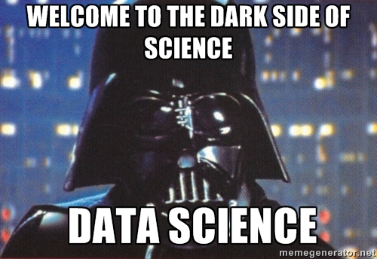

Slide 18
Data scientist

Slide 19
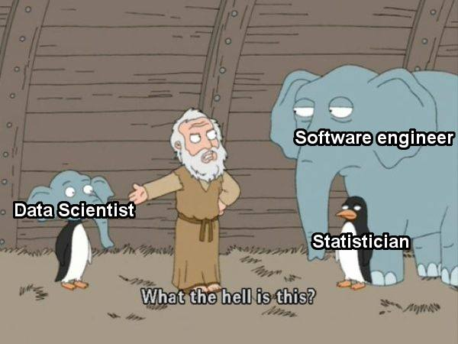

Slide 20
Data-related professions
Everybody works with Big Data (or they claim to do so)
Some roles came up:
Data Analyst
Data Engineer
Data Scientist
What is the difference between these roles?

Slide 21
Data Analyst
Analyzes data and uses them to guide decision-making
Keywords:
Data handling
Data modelling
Reports and visualizations for business needs and decision making

Slide 22
Data Engineer
Data architecture and preparation
Keywords
Very tech profile
Data pipelining
Infra-structure

Slide 23
Data Scientist
Analyzes and interprets complex data
A mixture between the aforementioned profiles, with a bias towards machine learning (ML)
Keywords
Statistical analysis
Deep knowledge in ML
Feature engineering and selection, class imbalance, dimensionality reduction, etc

Slide 24
Skills
Data Analyst | Data Engineer | Data Scientist
Report | Programming | Data mining
Effect data visualization | Deep SQL knowledge | Deep ML skills
SQL | Data architecture | Python and/or R skills
Spreadsheet software | Pipelining | Statistical analysis
 | ETL | Decision making

Slide 25
Income (July 2020)
Data Analyst
Aproximately USD 60k/yr
Data Engineer
Aproximately USD 92k/yr
Data Scientist
Aproximately USD 96k/yr
Fonte: https://www.payscale.com/

Slide 26
TOOLS

Slide 27
Tools
Python / Jupyter
Scikit-learn
Numpy
Pandas
Matplotlib
Seaborn
imblearn
Hint: if you want to use different tools, feel free to do so!

Slide 28

Google Colaborate
Google Colaboratory
https://colab.research.google.com
Colab has most of the tools we will need

Slide 29
PANDAS CRASH COURSE

Slide 30
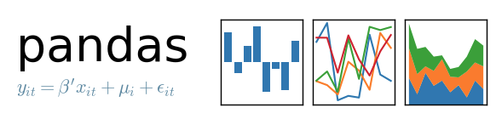
pandas
Open source library based on Numpy (C)
Data cleansing, preparation and analysis
Fair performance and productivity
Allows loading/saving data from/to different sources

Slide 31
Data input and output
We can read/write datasets in the following formats:

Slide 32
pandas
Works with tabular data
Does a good job when you have data that scales up to millions of rows and hundreds of columns
If you need to go further, think about Spark! ☺
Used in a multitude of academic and industrial projects

Slide 33
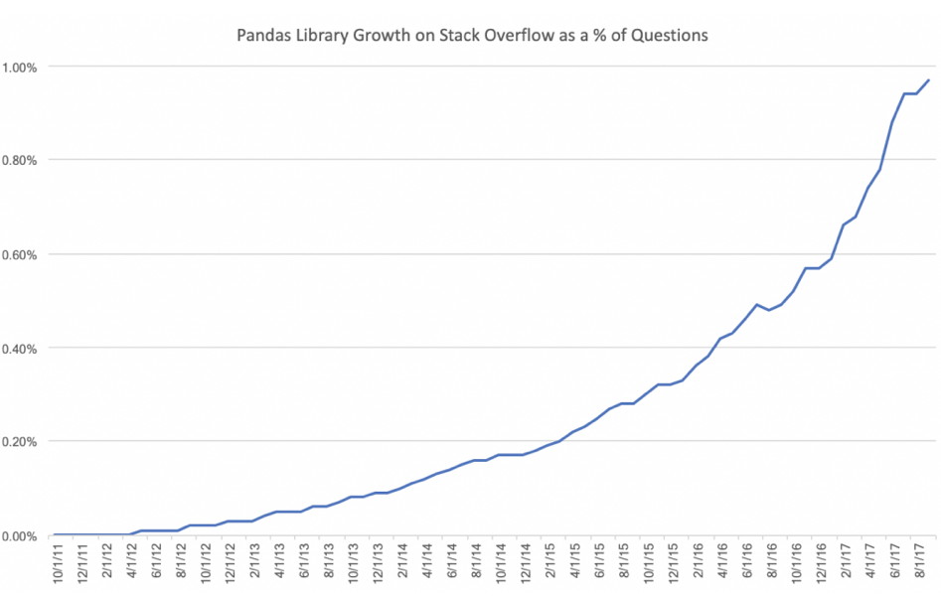
pandas
Percentage of questions about pandas on Stackoverflow over time

Slide 34
Overview of pandas
Data input and output
Series
DataFrames
Missing data
Group by
Operations
Feature engineering

Slide 35
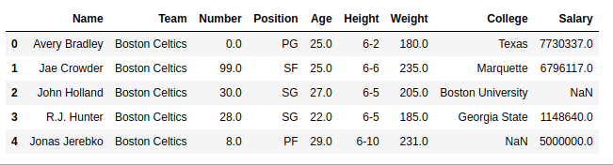
Series and DataFrames
A DataFrame is a bidimensional structure capable of storing heterogeneous data, i.e., each column (Series) has a different type
A Series is a single column (internally, it is a numpy array)
Therefore, a dataframe is a set of Series

Slide 36
Terminology
Columns are often referred to as attributes, features, variables, characteristics
Rows are often referred to as instances, registers, samples, examples.

Slide 37
Hint: loading data in Google Colab
The following link has some hints on loading data in Google Colab from Google Drive:
https://medium.com/@araujo.dionata/google-colab-importando-arquivos-direto-do-google-drive-5c0fc2798480

Slide 38
ACTIVITY

Slide 39
Working with Dataframes
Loading a dataset in pandas
Data selection, filtering, and indexing
Transposing a dataframe
Group by statement
Data sorting

Slide 40
YOUR TURN

Slide 41
Feature engineering
Feature engineering is extremely important for data analysis and machine learning
It allows the conversion, splitting and/or combining existing features according to our needs
Hint: Feature engineering is extremely relevant when machine learning is applied, as it may facilitate class separation
Hint #2: There is no rule on how to create new features, so give it a try. Create a new feature, analyze it, and even run ML models to see if accuracy improves.

Slide 42
Homework definition
In teams, go back to Kobe Bryant’s script
1- Apply different operations and data transformations over the dataset to find patterns in data
Try and focus on the behavior of variables w.r.t. whether the shots were made or not (shot_made_flag)
2- Create a new feature using the apply function. This feature must depend on 2 or more existing features and also be based on a condition (if statement)

